Slide 1
Jeopardy! Tutorial
This template is ready to use but since Jeopardy! is a quiz show, you can change the questions and answers of the template, in order to adapt the game to your topics.
Please do not delete whole slides, otherwise we can not guarantee a smooth game experience and problems may occur.
However, you can change texts, the music and colours. In the next slides we will give you a detailed explanation to learn how to play the game and adapt it to your ideas.
Have a lot of fun with our JEOPARDY! game!

Slide 2
Rules of Jeopardy!
To start the game, click on the first Jeopardy! Slide and start the presentation by clicking on the menu Slide Show > From Current Slide.
Now the intro with music starts playing and you only must click one more time to run the begin animation. When the second money board appears, the first player can choose the category and money- value by clicking on the field. (With the increasing amount of money, the difficulty of the questions also increases!)
As soon the question appears, the players have 30 seconds to think about it. (until music ends) When one person raises his arm (or shouts) he/ she can answer. Answers must be phrased as questions, unless it’s said differently.
Right answer? Then the player gets the amount of money, the question is worth. Take a sheet and write down the value to the persons' name. If he guessed it wrong, the other players could try their luck. If time runs out, or no one got it, no one will get any points. The person with the highest amount of money, wins.
Advanced version: guessing it wrong will subtract the amount of money from the players account; negative values are also accurate.

Slide 3
To change the text, click on the text field on the specific slide, then rewrite questions and answers.
Pictures can also be changed by selecting them and choosing “From a File” in the picture options “Picture Format”.
Some pictures are hidden behind other elements. In order to change them, move objects around and bring them to the front or back by right-clicking them and choosing the option.

Slide 4
More information can be found on our blog:
https://slidelizard.com/blog/jeopardy-powerpoint-template

Slide 6
PLEASE CLICK TO START THE GAME!

Slide 7
$ 200
$ 200
$ 200
$ 200
$ 200
$ 200
$ 400
$ 400
$ 400
$ 400
$ 400
$ 400
$ 600
$ 600
$ 600
$ 600
$ 600
$ 600
$ 800
$ 800
$ 800
$ 800
$ 800
$ 800
$ 1000
$ 1000
$ 1000
$ 1000
$ 1000
$ 1000

Slide 9
Family

Slide 11
PRODUCTION

Slide 13
DID YOU KNOW?

Slide 15
HISTORY

Slide 17
OVERVIEW

Slide 19
PICTURE PERFECT

Slide 20
FAMILY
DID YOU KNOW?
PICTURE PERFECT
PRODUCTION
HISTORY
OVERVIEW
YOU FINISHED THIS GAME
TIME TO COUNT THE MONEY!

Slide 21
The rose is a part of the _________ Family
Click here for the answer

Slide 22
Solution:
Rosacea
$ 200

Slide 23
The Rhododendron is a part of the ______
Family
Click here for the answer

Slide 24
Solution:
Ericaceae
$ 400

Slide 25
________ is a part of the Ranunculaceae Family
Click here for the answer

Slide 26
Solution:
Anemone
$ 600

Slide 27
________ is a part of the Euphorbiaceae Family
Click here for the answer

Slide 28
Solution:
Poinsettia
$ 800

Slide 29
What four flowers have the same family – Asteraceae
Click here for the answer

Slide 30
Solution:
Black-eyed Susan, Chrysanthemum, Dahlia and Sunflower
$ 1000

Slide 31
This flower ranks among the top three crops in floriculture, next to roses and carnations
Click here for the answer

Slide 32
Solution:
Chrysanthemum
$ 200

Slide 33
Peonies seldom are grown from seeds because they take about ______ to germinate
Click here for the answer

Slide 34
Solution:
Two Years
$ 400

Slide 35
When planted in the right conditions daffodils can bloom up to _________
Click here for the answer

Slide 36
Solution:
50 Years
$ 600

Slide 37
_____ will survive temperatures down to -20°F so long as it is not exposed to perpetual cold and wet
Click here for the answer

Slide 38
Solution:
Lavender
$ 800

Slide 39
Milkweed has a unique pollination mechanism in which the plant relies on _______ and ________ for pollination
Click here for the answer

Slide 40
Solution:
Lepidoptera (butterflies and moths) and Hymenoptera (bees, ants and wasps)
$ 1000

Slide 41
Anemones are not related to the sea, but are a close relative to _______
Click here for the answer

Slide 42
Solution:
Buttercups
$ 200

Slide 43
This flower attracts ants because of their fragrance and the sugary sap that the buds produce, but they are deer resistant
Click here for the answer

Slide 44
Solution:
Peony
$ 400

Slide 45
This is the state flower of
West Virginia
Click here for the answer

Slide 46
Solution:
Rhododendron
$ 600

Slide 47
The Black-eyed Susan is the state flower of this state.
Click here for the answer

Slide 48
Solution:
Maryland
$ 800

Slide 49
The genus name, Asclepias, commemorates Asklepios, the Greek god of ______
Click here for the answer

Slide 50
Solution:
Medicine
$ 1000

Slide 51
President Ronald Regan signed a
proclamation, certifying this flower as the National Floral Emblem of the United States
Click here for the answer

Slide 52
Solution:
Rose
$ 200

Slide 53
The Black-eyed Susan is native to the ______
Click here for the answer

Slide 54
Solution:
United States
$ 400

Slide 55
Dahlia’s originated from ________ and were first recorded in 1615
Click here for the answer

Slide 56
Solution:
Mexico
$ 600

Slide 57
The tallest sunflower was grown in _____ in 2014 measuring 30 ft. 1 in.
Click here for the answer

Slide 58
Solution:
Germany
$ 800

Slide 59
Daffodils are named after the mythological boy, ______
Click here for the answer

Slide 60
Solution:
Narcissus
$ 1000

Slide 61
This flower prefers at least six hours of direct sunlight and it follows the sun from sunrise to sunset
Click here for the answer

Slide 62
Solution:
Sunflower
$ 200

Slide 63
This plant has a wide range of uses some being ornamental, fragrance, culinary and medicinal
Click here for the answer

Slide 64
Solution:
Lavender
$ 400

Slide 65
This plant blooms open during the day and closes at night
Click here for the answer

Slide 66
Solution:
Anemone
$ 600

Slide 67
This is the #1 selling potted plant in America
Click here for the answer

Slide 68
Solution:
Poinsettia
$ 800

Slide 69
Crysanthemums are ________ plants, which means they are day-light sensitive
Click here for the answer

Slide 70
Solution:
Photoperiodism
$ 1000

Slide 71
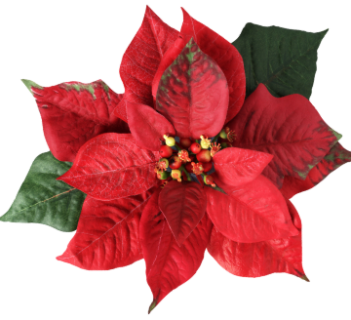
What is pictured below
Click here for the answer

Slide 72
Solution:
Poinsettia
$ 200

Slide 73
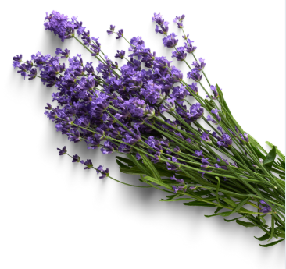
What is pictured below
Click here for the answer

Slide 74
Solution:
Lavender
$ 400

Slide 75
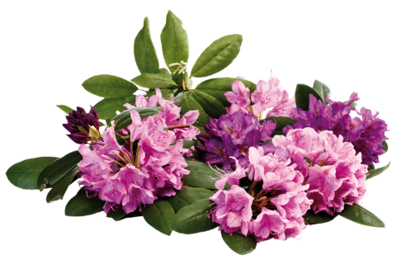
Click here for the answer

Slide 76
Solution:
Rhododendron
$ 600

Slide 77
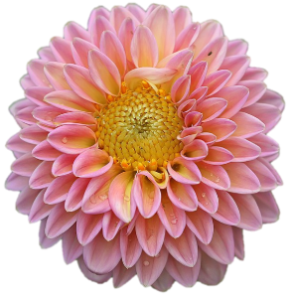
Click here for the answer

Slide 78
Solution:
Dahlia
$ 800

Slide 79
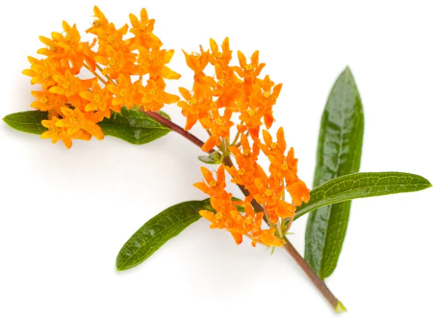
Click here for the answer

Slide 80
Solution:
Milkweed
$ 1000

Slide 81
Free Download:
https://slidelizard.com

